Slide 1
Cryogenic Considerations for Cryomodule Design
Tom Peterson, SLAC
USPAS
January 2017

Slide 2
Outline
Introductory comments about considerations for cryomodule design and helium flow
Practical superfluid heat transport considerations
Overview of typical cryomodule requirements
Stand-alone versus long cryogenic string
Survey of cryomodule configurations

Slide 3
Cryomodule requirements -- major components
Dressed RF cavities
RF power input couplers
Intermediate temperature thermal shield or shields
Heat exchanger for 4.5 K to 2.2 K precooling of the liquid supply flow if stand-alone style
Cryogenic valves if stand-alone style
  2.0 K liquid level control valve
  Cool-down/warm-up valve
  5 K thermal intercept flow control valve
Pipe and cavity support structure
Instrumentation -- RF, pressure, temperature, etc.
Bayonet connections for helium supply and return

Slide 4
Cryomodule requirements -- major interfaces
Bayonet connections for helium supply and return
Vacuum vessel support structure
Beam tube connections at the cryomodule ends
RF waveguide to input couplers
Instrumentation connectors on the vacuum shell
Alignment fiducials on the vacuum shell with reference to cavity positions.

Slide 5
Design considerations
Cooling arrangement for integration into cryo system
Pipe sizes for steady-state and emergency venting
Pressure stability factors
  Liquid volume, vapor volume, liquid-vapor surface area as buffers for pressure change
    Evaporation or condensation rates with pressure change
Heat load estimates and uncertainty
Options for handling 4.5 K (or perhaps 5 K - 8 K) thermal intercept flow
Alignment and support stability
Thermal contraction and fixed points with closed ends

Slide 6
CW cryomodule requirements
1 A “stand-alone” cryomodule is closed at each end, individual insulating vacuums, with warm beam pipe and magnets in between cryomodules such that individual cryomodules can be warmed up and removed while adjacent cryomodules are cold.
2 Provide the required insulating and beam vacuum reliably
3 Minimize cavity vibration and coupling of external sources to cavities
4 Provide good cavity alignment (typically <0.5 mm)
5 Allow removal of up to 250 W at 2 K per cryomodule if CW
6 Protect the helium and vacuum spaces including the RF cavity from exceeding allowable pressures.
7 Intercept significant heat loads at intermediate temperatures above 2.0 K to the extent possible (cavity internal power generation cannot be intercepted)
8 Provide high reliability in all aspects of the cryomodule (vacuum, alignment stability, mechanics, instrumentation) including after thermal cycles
9 Provide excellent magnetic shielding for high Q0
10 Minimize cost (construction and operational)

Slide 7
Further considerations
Support structure
  Stiffness of pipe if used as support backbone
  Or other support structure options
Emergency venting scenarios drive pipe sizes and influence segmentation
  Cold MAWP may be low, driving up pipe sizes and/or reducing spacing between relief vent ports
  Trade-off of pipe size with vent spacing
  Thermal shield pipe may also require frequent venting
    5 K may have large surface area for large heat flux
    70 K helium typically starts at a high pressure
Liquid management length
  May want to subdivide strings for liquid management due to large specific liquid flow rate per cavity
Notes:
7

Slide 8
Pool boiling and 2-phase flow
Considerations for pool boiling systems
  Control of liquid levels, long time constants, inventory management
  Forced convection for warm-up and cool-down
Two-phase flow
  Liquid and vapor phases separate with any acceptably low pressure drop
  Baker Plot does not apply!

Slide 9
Provisions for cool-down and warm-up
Cool-down
  Return vapor may block liquid supply flow in the same channel; a simple fill from the top or one end might not work. A cool-down vent and/or a bottom-fill port may be required.
Warm-up
  Flow will stratify. Local electric heat, a bottom vent port, or other feature to force heat down to the lower parts of a cold mass may be required.
    The small “capillary” tubes connected to a manifold and providing helium to the bottoms of helium vessels in TESLA-style cryomodules were included primarily with warm-up in mind

Slide 10
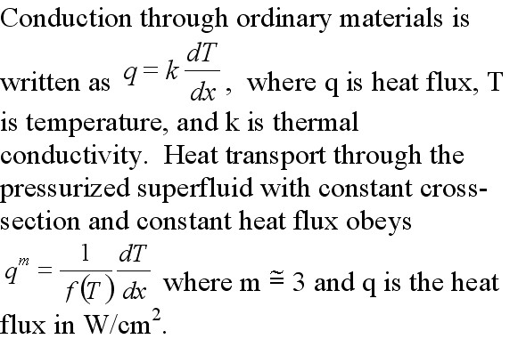
Helium II heat transport

Slide 11
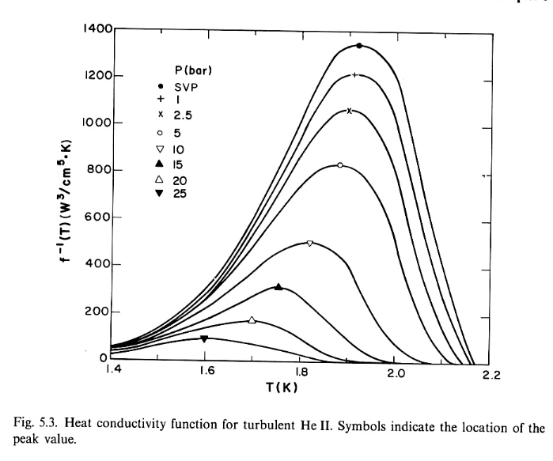
He II heat function
Figure from
Steven Van Sciver, Helium Cryogenics, Plenum Press,
New York, 1986.

Slide 12
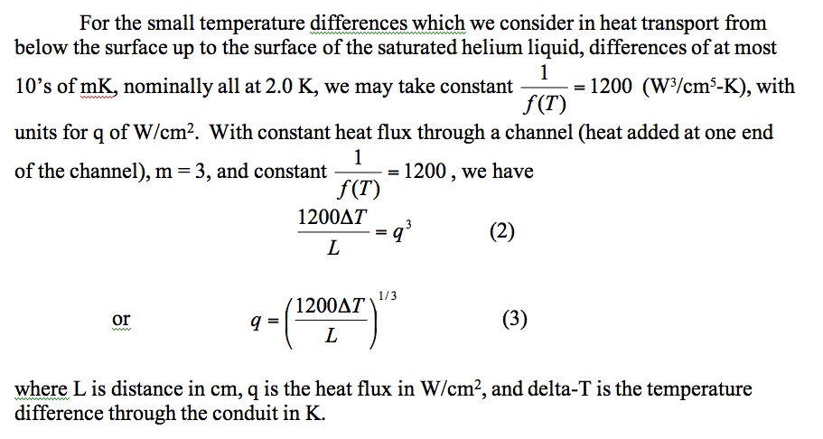
Helium II heat transport -- near saturation pressure

Slide 13
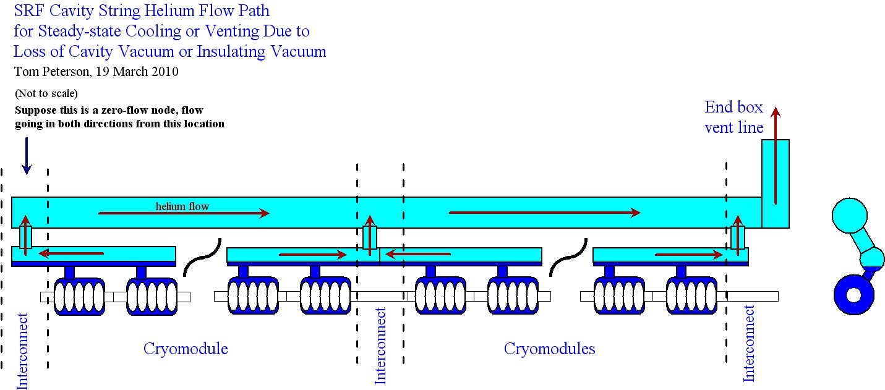
2-pipe 2 Kelvin vapor system
650 MHz cryomodule a modified TESLA-type
Notes:
13

Slide 14
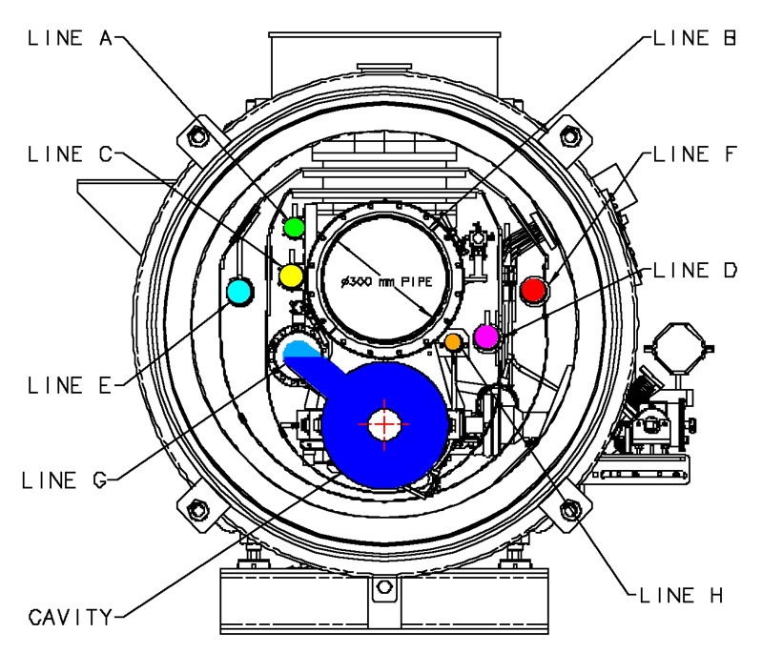
TTF cryomodule cross-section

Slide 15
Heat transport vertically to surface
Recall from our normal fluids behavior discussion, the pressure head of liquid helium and Clapeyron Equation tell us that helium saturation temperature increases by about 1.5 mK/cm of depth.
Substituting 0.0015 K/cm into equation (3) on slide 12 results in 1.2 W/cm² heat flux vertically to the surface of the helium II. Note that this heat flux is essentially independent of depth for the depths of 10’s of cm typical of RF helium vessels. I use 1 W/cm² as a limit for sizing a conduit for heat transport to the surface of a saturated helium II bath.

Slide 16
Helium vessel style
Helium vessel style (open vs. closed) is independent of support style (hung from 300 mm pipe, space frame, rails)
High heat loads and tight pressure stability ==>
  Large liquid-vapor surface area for liquid-vapor equilibrium
  Acts as thermal/pressure buffer with heat and pressure changes
Linac is short enough that total helium inventory not an issue ==>
  Open helium vessel is feasible
For the stand-alone CW cryomodule, a closed TESLA-type helium vessel may be favored by
  Tuner design
  Input coupler design
  And allowed by reduced pressure sensitivity

Slide 17
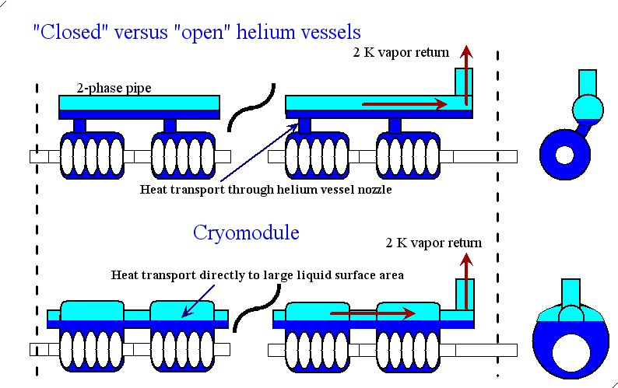
Helium vessel style and pressure stability
Rate of return
to vapor-liquid
equilibrium
following a
pressure change
is limited by
the rate of heat
transport through
the “chimney”
for the closed
helium vessel.
Rate based on
surface areas is
about a factor
60 higher for the
“open” vessel.

Slide 18
Cryomodule Pipe Sizing Criteria
Heat transport from cavity to 2-phase pipe
  1 Watt/cm² is a conservative rule for a vertical pipe (less heat flux with horizontal lengths)
Two phase pipe size
  5 meters/sec vapor “speed limit” over liquid
  Not smaller than nozzle from helium vessel
Gas return pipe (also serves as the support pipe in TESLA-style CM)
  Pressure drop < 10% of total pressure in normal operation
  Support structure considerations
Loss of vacuum venting P < cold MAWP at cavity
  Path includes nozzle from helium vessel, 2-phase pipe, may include gas return pipe, and any external vent lines
Notes:
18

Slide 19
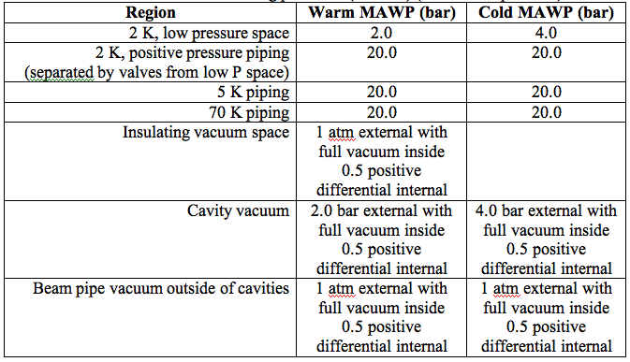
Cryomodule requirements -- typical vessel and piping pressures

Slide 20
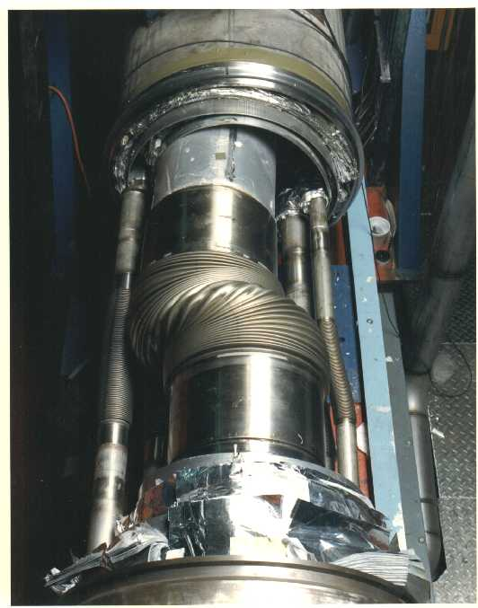
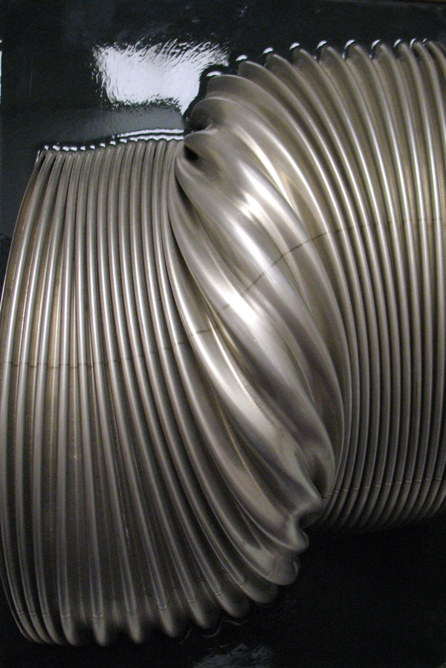
Pressure-induced pipe instability

Slide 21
Lateral elastic pipe instability
Lateral displacement force is proportional to lateral displacement and to pressure
If the restoring spring constant of the piping system in which the bellows is installed is less than the constant relating lateral displacement force to lateral displacement (a “negative spring constant”) at a given pressure, the system is transversely, elastically unstable at that pressure.
Relatively light pipe supports near the bellows can prevent this instability by adding stiffness.

Slide 22
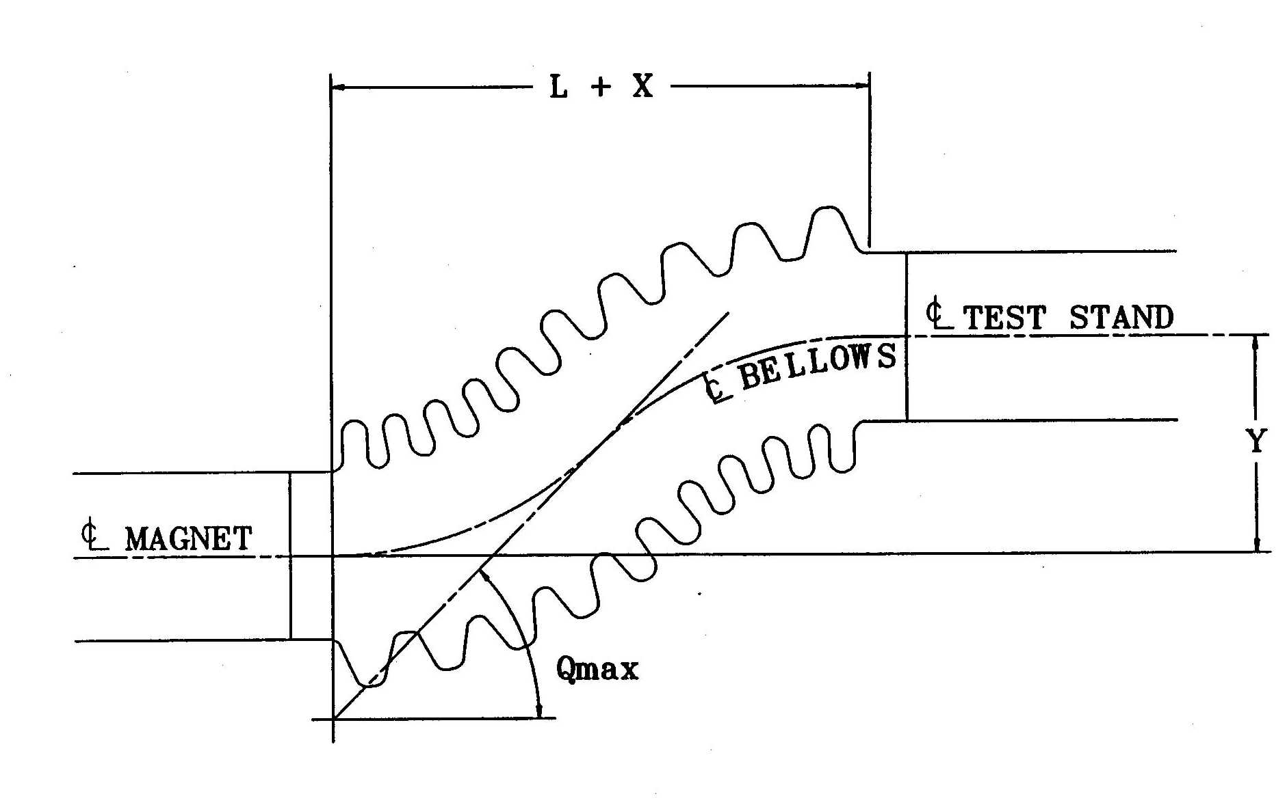
Displacement force proportional to displacement

Slide 23
Pipe instability analysis
Lateral pipe instability: displacement force is proportional to displacement (unpublished paper by P.O. Mazur, Fermilab)
F(P) = PAsin(Q_{max}) where F(P) is the lateral force as a function of pressure, P is pressure in the system (vacuum outside), A is bellows areas, and Q_{max} is the maximum angle of displaced convolutions
Q_{max} = 3Y/(2(L+X)), where X, Y, and L are shown in the previous figure
For small angles, F(P)/Y = 3 PA/(2(L+X))
Instability occurs when F(P)/Y exceeds the restoring spring constant, determined by bellows and pipe stiffness

Slide 24
US LHC high gradient quad (Q2P1) cold mass, support rings, and internal piping
(from Tom Nicol, Fermilab)
Pipe supports are added
at each end and at the
center for stability

Slide 25
Axial pressure forces
Walls in tension
Bellows does not carry tensile load
Pressure-containing pipes and vessels carry tension in their walls due to pressure forces
Introduction of a bellows or elastic element introduces the possibility of unbalanced forces on the piping
  Combination of bellows and elbow are often overlooked
The following slide shows a free body diagram for a helium vessel within a cryogenic supply box for LHC at CERN

Slide 26
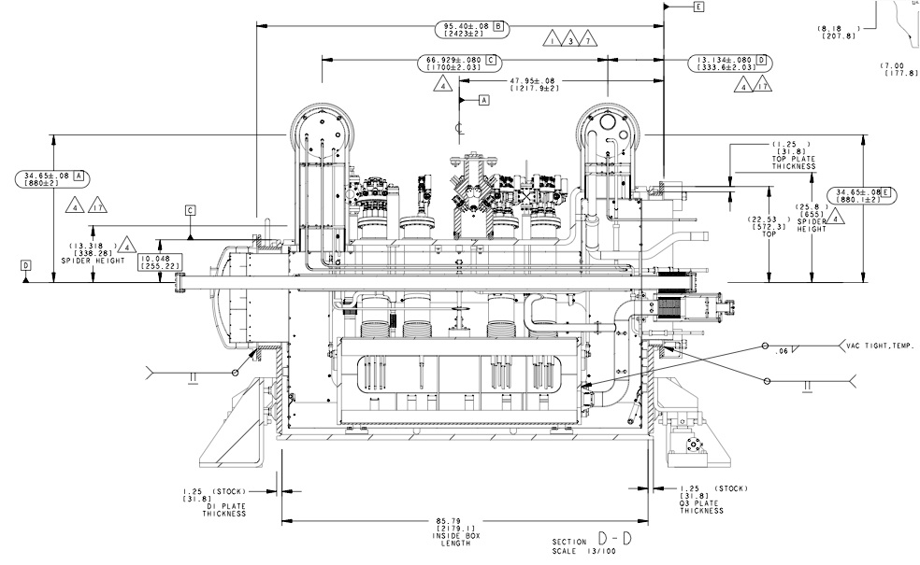
Forces on DFBX-E due to 20 bar M1 line pressure plus 3.5 bar in the helium vessel
66.8 kN (15000 lbf)
(Combined pressure and gravity)
20.0 kN
(4500 lbf)
635 mm
(25.0 in)
10.0 kN (2250 lbf) x 2
767 mm
(30.2 in)
20.8 kN (4680 lbf) x 2
(rods in tension)
12.5 kN (2820 lbf) x 2
(rods in tension)

Slide 27
Thermal intercepts
With no thermal intercept,
assume a heat flux of
1 W/sq.cm. to 2.0 K
Then adding an 80 K intercept
at the midpoint results in
0.23 W/sq.cm. to 2.0 K and
1.77 W/sq.cm. to 80 K

Slide 28
Thermal intercept benefit
From previous illustration:
  No thermal intercept:
    1 W/sq.cm. to 2 K x 700 W/W = 700 W of room temperature power per sq.cm. of rod between 2 K and 300 K
  With thermal intercept:
    0.23 W/sq.cm. to 2 K x 700 W/W + 1.77 W/sq.cm. to 80 K x 12 W/W = 161 W + 21 W = 182 W of room temperature power per sq.cm. of rod between 2 K and 300 K

Slide 29
S1-Global cryomodule
Tested at KEK in 2010 – 2011
A TESLA-type cryomodule but consisting of two 4-cavity cryomodules joined end-to-end
Cavities from FNAL, DESY, KEK
Thoroughly instrumented and careful heat load studies conducted by Norihito Ohuchi (KEK)

Slide 30
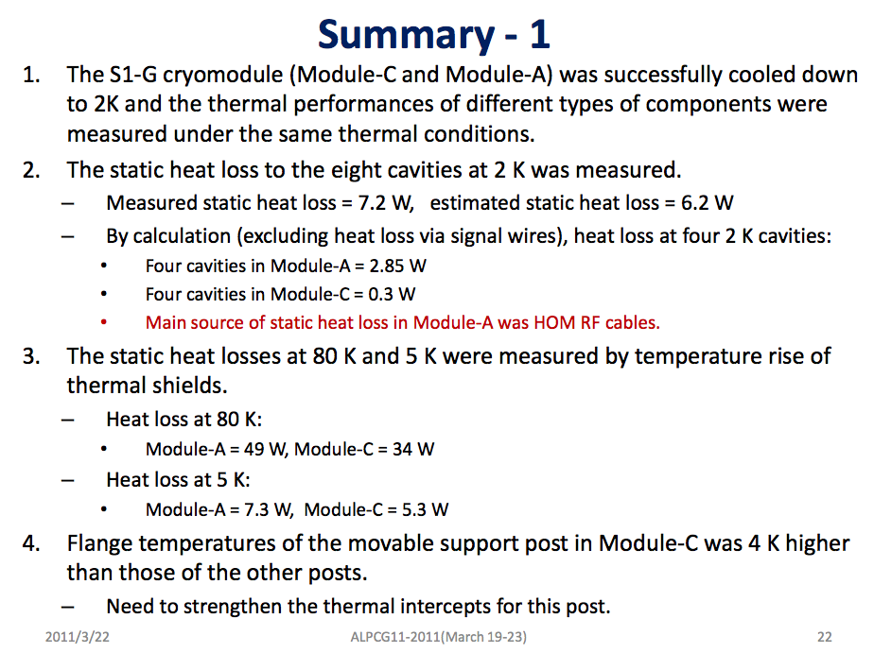
From Norihito Ohuchi (KEK)

Slide 31
Measured thermal radiation heat
Measured in above-mentioned S1-Global studies at KEK
  1.62 W/m² from 300 K to 80 K thermal shield
  0.045 W/m² from 80 K thermal shield to 5 K thermal shield
My “rule of thumb” (pre-dates S1-Global)
  1.5 W/m² from 300 K to 80 K thermal shield
  0.05 W/m² from 80 K thermal shield to 5 K thermal shield

Slide 33
Cryogenic unit length limitations
25 KW total equivalent 4.5 K capacity
  Heat exchanger sizes
  Over-the-road sizes
  Experience
Cryomodule piping pressure drops with 2+ km distances
Cold compressor capacities
With 192 modules, we reach our plant size limits, cold compressor limits, and pressure drop limits
192 modules results in 2.47 km long cryogenic unit
5 units (not all same length) per 250 GeV linac
  Divides linac nicely for undulators at 150 GeV

Slide 34
Heat loads scaled from
TESLA TDR

Slide 35
Module predicted heat loads -- 2K
TESLA ILC 9-8-9

Slide 36
Module predicted heat loads -- 5K
TESLA ILC 9-8-9

Slide 37
Module predicted heat loads -- 40K
TESLA ILC 9-8-9

Slide 38
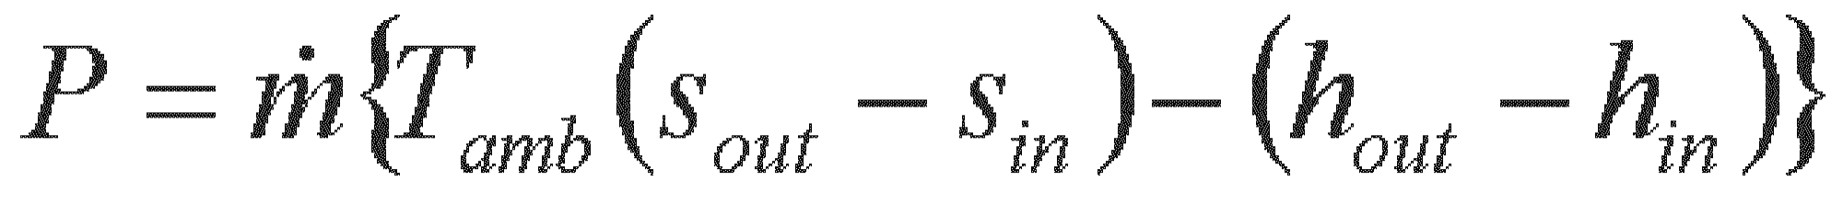
Power required for a non-isothermal load
Use
Where P is the ideal room-temperature power required to remove a non-isothermal heat load
I will show the use of this later in calculating the ILC cryogenic system power

Slide 39
Cryogenic unit parameters

Slide 40
CERN LHC capacity multipliers
We have adopted a modified version of the LHC cryogenic capacity formulation for ILC
Cryo capacity = Fo x (Qd x Fud + Qs x Fus)
  Fo is overcapacity for control and off-design or off-optimum operation
  Qs is predicted static heat load
  Fus is uncertainty factor static heat load estimate
  Fud is uncertainty factor dynamic heat load estimate
  Qd is predicted dynamic heat load

Slide 41
Heat Load evolution in LHC
Basic Configuration: Pink Book 1996
Design Report: Design Report Document 2004
Temperature level | Heat load increase w/r to Pink Book | Main contribution to the increase
50-75 K | 1,3 | Separate distribution line
4-20 K | 1,3 | Electron-cloud deposition
1,9 K | 1,5 | Beam gas scattering, secondaries, beam losses
Current lead cooling | 1,7 | Separate electrical feeding of MB, MQF & MQD
At the early design phase of a project, margins are needed to cover unknown data or project configuration change.

Slide 42
Cryogenic system design
Fairly complete accounting of cold devices with heat load estimates and locations
  Some cold devices still not well defined
  Some heat loads are very rough estimates
Cryogenic plant capacities have been estimated
  Overall margin about 1.54
  Main linac plants dominate, each at 20 kW @ 4.5 K equiv.
Component conceptual designs (distribution boxes, end boxes, transfer lines) remained sketchy
  Need these to define space requirements and make cost estimates
  Used area system lattice designs to develop transfer line lengths and conceptual cryosystem layouts

Slide 43
Cryomodule string segmentation
Various degrees of possible segmentation
  Total isolation and warm-up with adjacent cryomodule cold
  Total separation of vacuum and cryogenic circuits but no provisions for maintaining segments cold which are adjacent to warm cryomodules
    Limits extent of control lengths and vacuum
    No end buffer from adjacent cold segment for vacuum let-up of warm segment. E.g., one must warm three segments to let up one.
    Segments downstream of warm one may not be held cold
  Vacuum isolation and/or cryo circuit extent of various lengths, not all equal
    For example, liquid flow path shorter than thermal shield circuits
    Some valves distributed more finely than others. May have small “feed boxes” or valves in cryomodules for 2 K liquid supply.
  Relief valve frequency -- low MAWP may force frequent vents
Pipe sizes trade off with segmentation lengths
Notes:
43

Slide 44
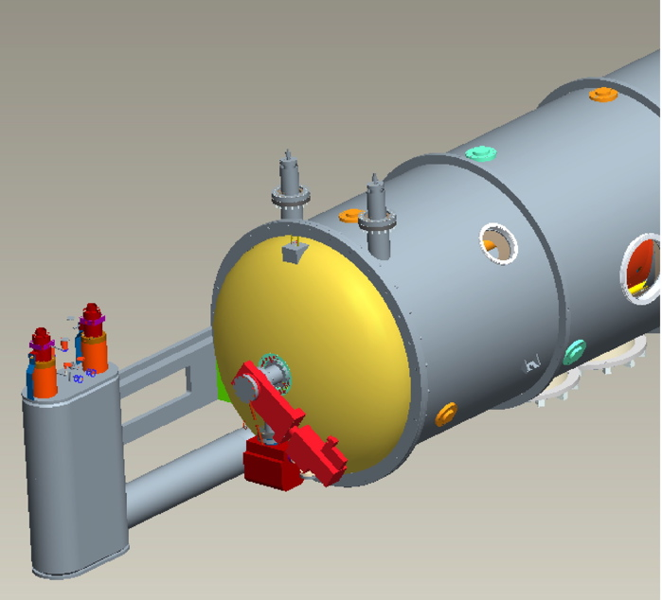
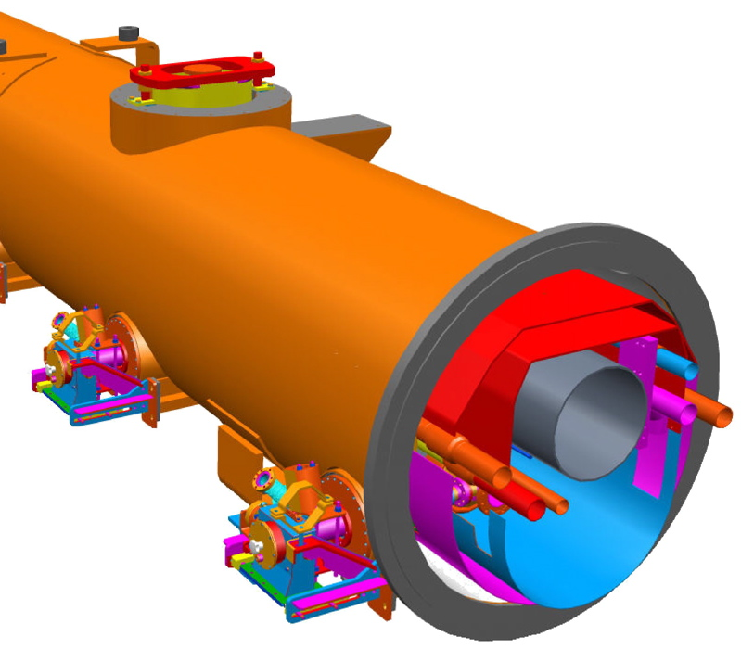
SNS vs TTF cryomodule
TTF: vacuum vessel string.
End boxes and bellows
would become part of
vacuum/pressure closure
SNS (like CEBAF):
self-contained vacuum vessel
“stand-alone” style

Slide 45
Advantages of separated cryomodules (1)
Separated liquid management. High heat loads for high duty factor or CW cryomodules imply high 2 Kelvin boil off rates. Managing the liquid level in the helium vessels and flow through the JT valve and 2-phase pipe or series of helium vessels will be easier with a shorter length of liquid baths.
Prefer small heat exchangers, distributed with cryomodules. In general, in my opinion, a JT heat exchanger of a size comparable to those in LHC which place the heat loads in the large transfer line at the 4.5 K level will be preferable.
Warm magnets and instrumentation between cryomodules. Separate cryomodules allow warm beam line components between cryomodules, especially useful for easier alignment of magnets and BPM's, other instrumentation, and also for absorbing some HOM power if applicable.
Active pumping between cryomodules. If needed, the insulating vacuum of a single cryomodule may be pumped, and the beam vacuum is accessible for pumping.

Slide 46
Advantages of separated cryomodules (2)
Loss of insulating vacuum to air is limited to one cryomodule (assuming vacuum isolation from the transfer line). The sudden rush of air into insulating vacuum and resulting heat fluxes with air condensation can deposit up to several Watts per square cm on liquid helium-temperature vessels and piping, depending on insulation. For a string of cryomodules, this can result in huge flow rates with requirements for extremely large vent lines and venting devices. The separate cryomodule vacuums limit this disaster to one cryomodule for the insulating vacuum loss.
Replacement for maintenance. Separate cryomodules allow replacement of individual cryomodules without warming the entire string.
Testing and commissioning. Separate cryomodules allow installation and cryogenic operation of individual cryomodules or parts of the linac during installation and commissioning.
Incorporation and connection of low-beta cryomodules of different types, for example FRIB. Separated cryomodules will reduce constraints imposed by matching cold interconnects and allow easier transitions among different types of cryomodules, also allowing the top-loading configuration.

Slide 47
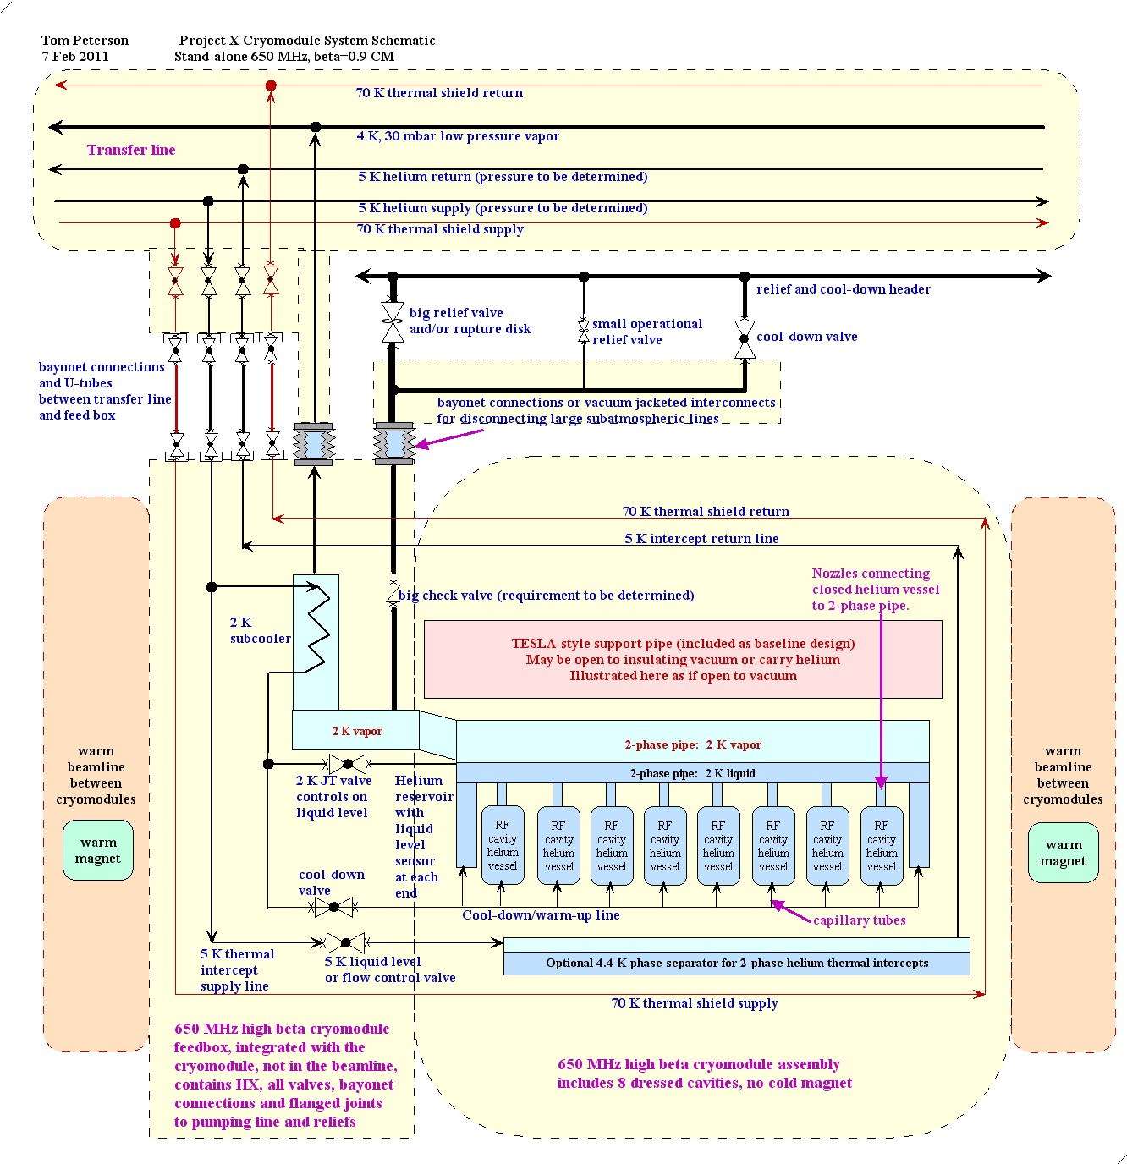
Stand-alone
cryomodule
schematic

Slide 48
Advantages of string
No external transfer line. A large transfer line with vacuum-jacketed 4 K pumping line may be $5000 to $10,000 per meter including all the connections to the cryomodules. So for a 10 meter long cryomodule, it may add the equivalent of another $50K to $100K or so to the CM cost, as well as occupy tunnel space. I think the external transfer line cost is the major cost difference between these two configurations. Incorporation of the transfer line into the cryomodule piping was one of the main motivations for the TESLA design.
Fewer cryogenic valves. By placing the helium vessels and other piping of multiple cryomodules in series, one valve at a feed or turnaround box controls the flow through many cryomodules. This may provide significant cost reduction (in addition to the elimination of the external transfer line) and also simplify operations (assuming control of the long volumes is not a problem) by resulting in fewer control valves.
No warm-cold transitions at the ends. Especially for systems with relatively low dynamic heat loads where static heat load is more significant, eliminating the warm-cold transitions at each end helps reduce heat load. It may also result in a simpler end since one just has a connection to another pipe, no turn-arounds or pressure-load-bearing ends. However, I do not believe that closing the end is more expensive (as some have claimed) than the huge vacuum bellows and other features of an interconnect.

Slide 49
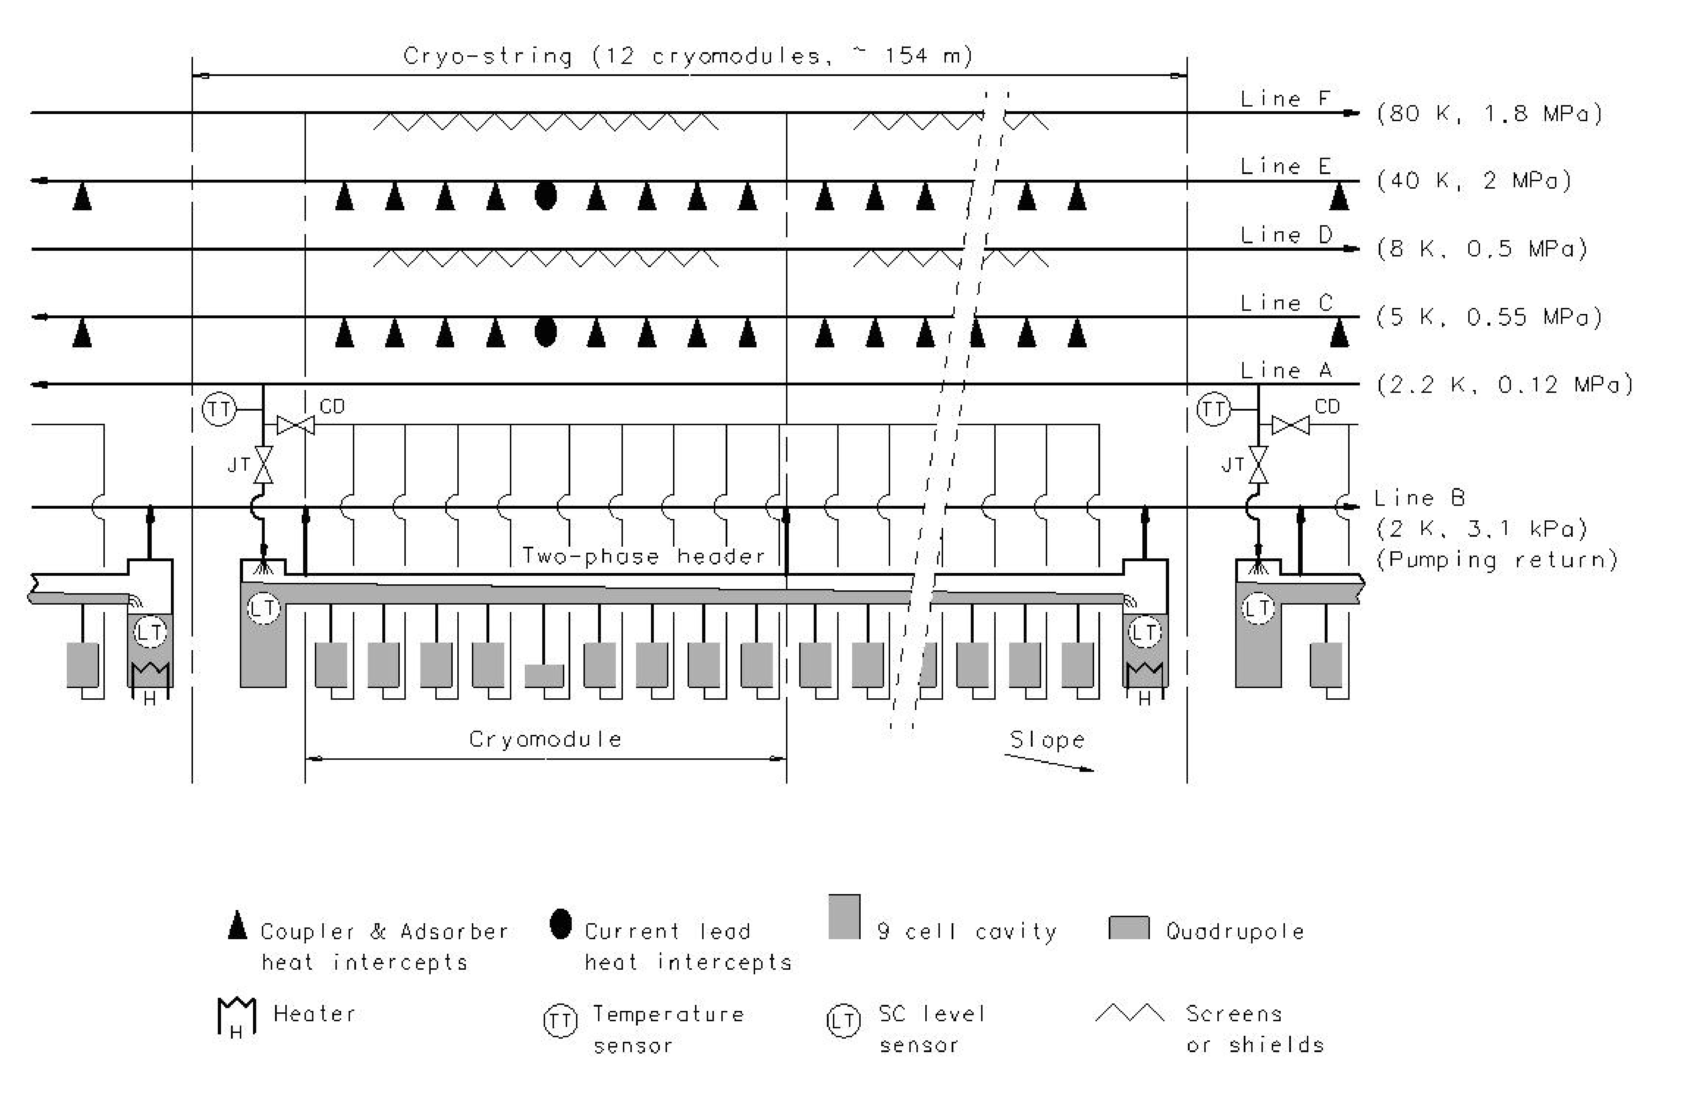
ILC cryomodule cooling scheme
Still essentially
unchanged from
the TESLA scheme

Slide 50
From Shrikant Pattalwar, STFC Daresbury, UK

Slide 51
Various cryomodule concepts
Single Spoke Resonator (SSR) cryostat concept using support posts under the cavities and magnets
TESLA/ILC
SNS/Jlab 12 GeV upgrade style “space frame” supports
Closed-ended “TESLA” style
BESSY/HZB CW cryomodule string rather than stand-alone cryomodules
Cornell’s ERL cryomodule
ANL/FRIB/TRIUMF-style top-loading rectangular cryostats

Slide 52
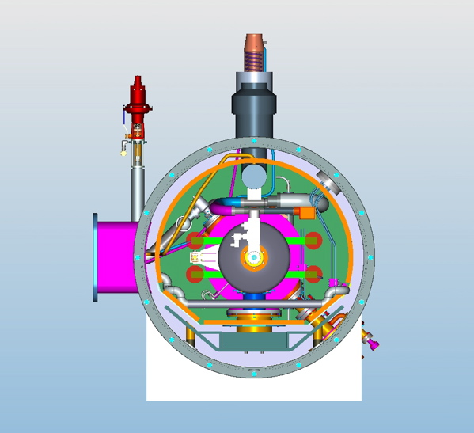
SSR cryomodule concept
Vacuum vessel end removed
Support structure is a cradle on which magnets and cavities are supported

Slide 53
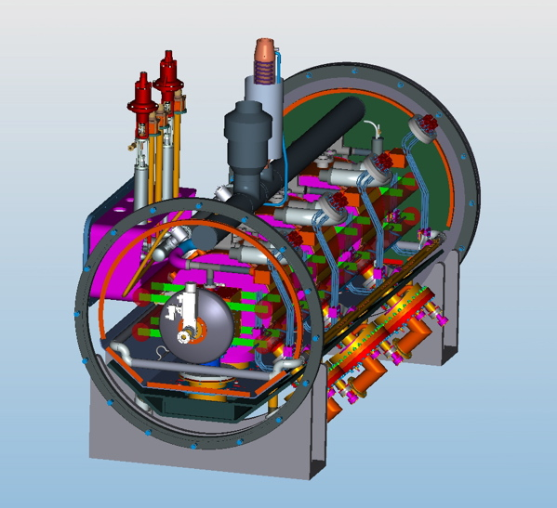
SSR cryomodule concept
Heat exchanger
Current leads
Input couplers
48 inch diameter vacuum vessel

Slide 54
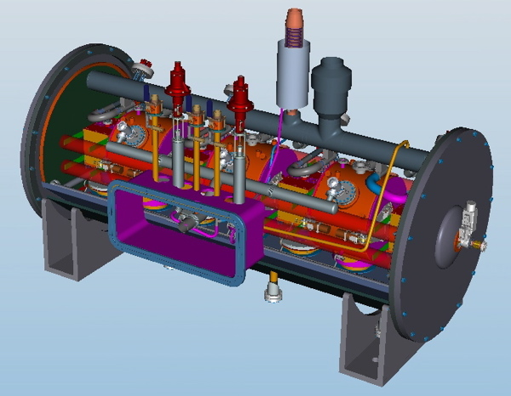
SSR cryomodule concept
Still working on conceptual
design as 3-D model, but
becoming a complete model
Heat exchanger
Cavity helium vessel
Bayonet connection
Control valve
Vent line with check valve

Slide 55
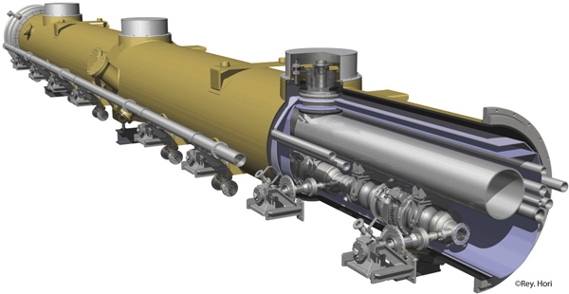
TESLA-style Cryomodule

Slide 56
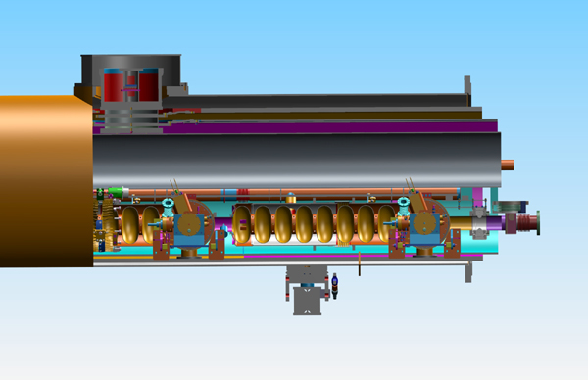
Cutaway view of cavity within a cryomodule

Slide 57
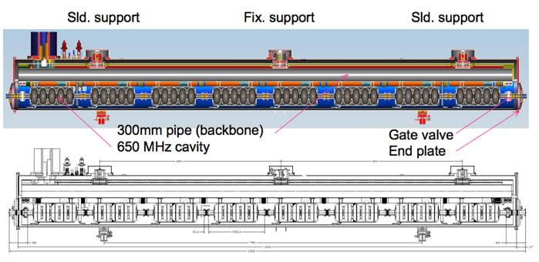
Closed ended “TESLA” style

Slide 58
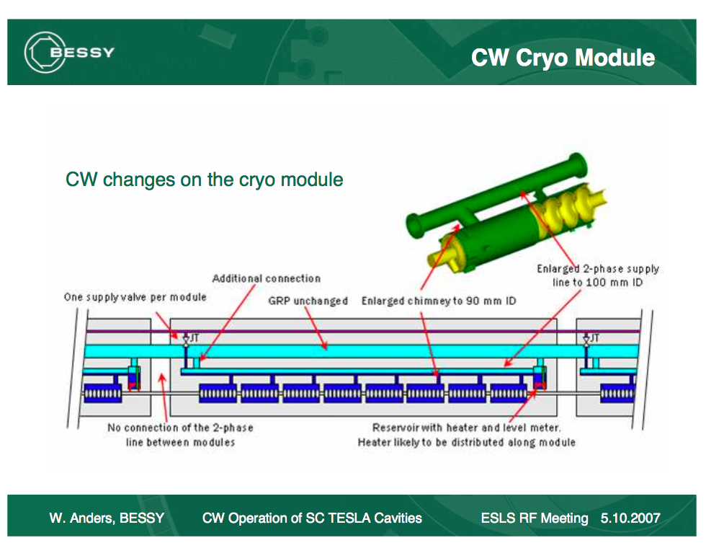

Slide 59
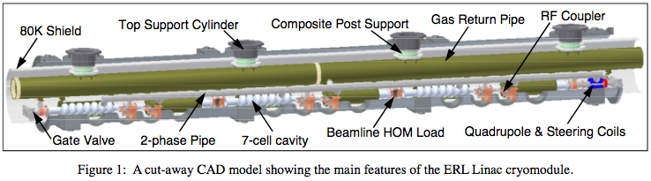
ERL cryomodule features
Figure 1 from CRYOGENIC HEAT LOAD OF THE CORNELL ERL MAIN LINAC CRYOMODULE, by
E. Chojnacki, E. Smith, R. Ehrlich, V. Veshcherevich and S. Chapman, Cornell University, Ithaca, NY, U.S.A.
Published in Proceedings of SRF2009, Berlin, Germany

Slide 60
ERL cryomodule features
TESLA-style support structure -- dressed cavities hang from gas return pipe (GRP), but
  Titanium GRP
  No invar rod, no rollers
  6 cavities per CM, 9.8 m total CM length
  HOM absorbers at 40 - 100 K between cavities
  GRP split with bellows at center, 4 support posts
  Helium vessels pinned to GRP
  Some flexibility in the input coupler
  De-magnetized carbon-steel shell for magnetic shielding (this is like TTF)
  2-phase pipe closed at each CM end, JT valve on each CM (like BESSY design)
  String rolls into vacuum vessel on rails

Slide 61
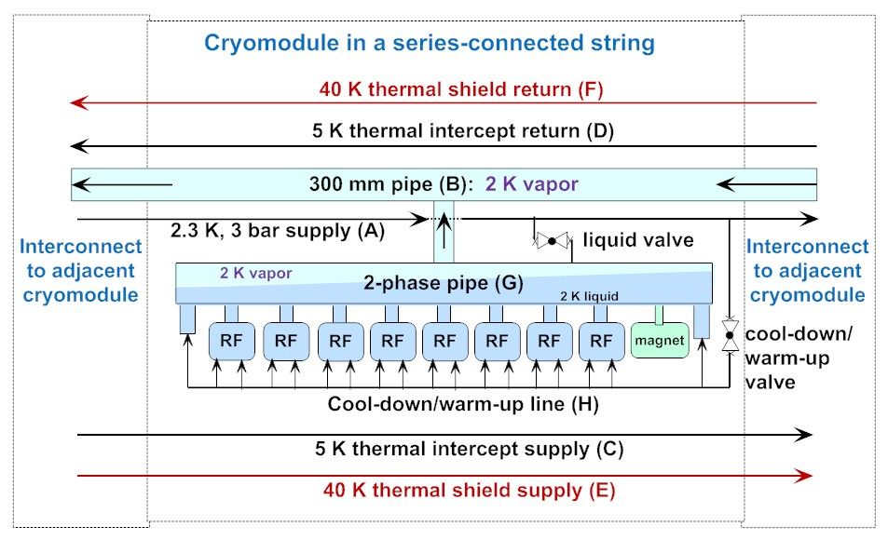
LCLS-II cryomodule flow scheme

Slide 62
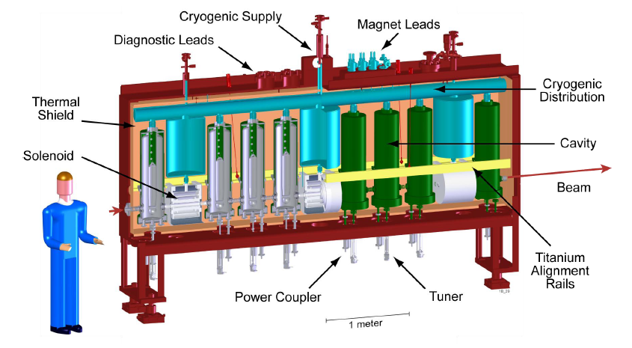
FRIB cryomodule
“bathtub” style for comparison

Slide 63
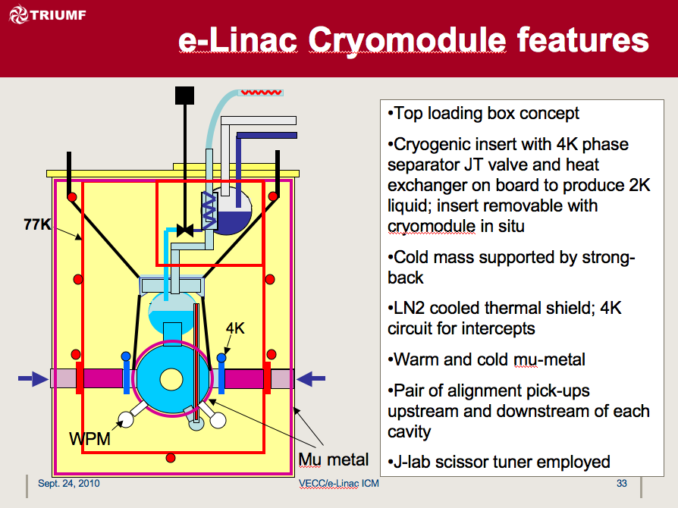
TRIUMF cryomodule concept
“bathtub” style with 1.3 GHz cavities for comparison

Slide 64
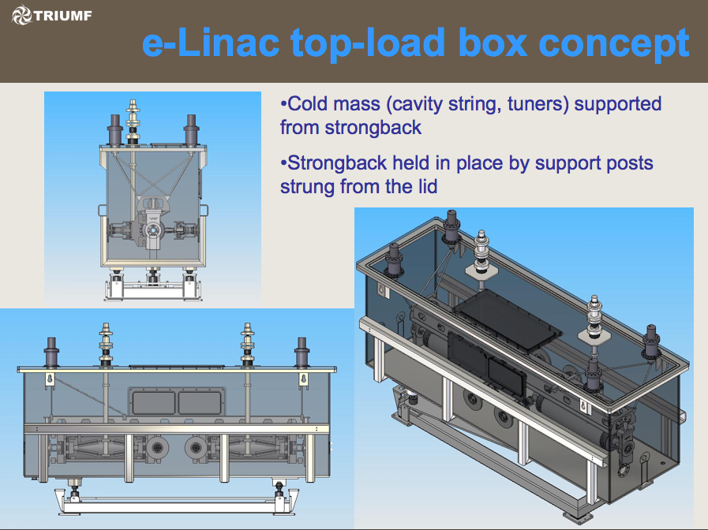

Slide 65
Conclusions
Cryomodule must be designed as part of the larger cryogenic system
Vacuum and cryogenic line segmentation choices depend on heat loads as well as various mechanical, alignment, and reliability considerations
Off-design requirements such as emergency venting may determine line sizes and design features
There is no single best design configuration. A variety of quite different designs already exist with features appropriate to the various specific applications

Slide 66
References -- 1
ASME Boiler & Pressure Vessel Code, 2007 Edition, July 1, 2007
  Primarily Section VIII, Division 1 and Division 2
ASME B31.3-2008, Process Piping, ASME Code for Pressure Piping
R. Byron Bird, Warren E. Stewart, Edwin N. Lightfoot, “Transport Phenomena,” John Wiley &Sons, 1960.
S. W. VanSciver, “Helium Cryogenics,” Plenum Press, 1986.
CGA S-1.3, “Pressure Relief Device Standards”, Compressed Gas Association, 2005.

Slide 67
References -- 2
Fermilab’s ES&H Manual (FESHM) pressure vessel standard, FESHM 5031
  http://esh-docdb.fnal.gov/cgi-bin/ShowDocument?docid=456
FESHM Chapter 5031.6 - Dressed Niobium SRF Cavity Pressure Safety
  And associated document: “Guidelines for the Design, Fabrication, Testing and Installation of SRF Nb Cavities,” Fermilab Technical Division Technical Note TD-09-005
  http://esh-docdb.fnal.gov/cgi-bin/ShowDocument?docid=1097

Slide 68
References -- 3
W. Lehman and G. Zahn, “Safety Aspects for LHe Cryostats and LHe Transport Containers,” ICEC7, London, 1978
G. Cavallari, et. al., “Pressure Protection against Vacuum Failures on the Cryostats for LEP SC Cavities,” 4th Workshop on RF Superconductivity, Tsukuba, Japan, 14-18 August, 1989
M. Wiseman, et. al., “Loss of Cavity Vacuum Experiment at CEBAF,” Advances in Cryogenic Engineering, Vol. 39, 1994, pg. 997.
T. Boeckmann, et. al., “Experimental Tests of Fault Conditions During the Cryogenic Operation of a XFEL Prototype Cryomodule,” DESY.

Slide 69
References -- 4
E. G. Brentari, et. al., “Boiling Heat Transfer for Oxygen, Nitrogen, Hydrogen, and Helium,” NBS Technical Note 317, 1965.
NBS Technical Note 631, “Thermophysical Properties of Helium-4 from 2 to 1500 K with Pressures to 1000 Atmospheres”, 1972.
Vincent D. Arp and Robert D. McCarty, “Thermophysical Properties of Helium-4 from 0.8 to 1500 K with Pressures to 2000 Atmospheres,” National Institute of Standards and Technology (NIST) Technical Note 1334, 1989.
HEPAK (by Cryodata, Inc.)

Slide 70
References -- 5
“Flow of Fluids through Valves, Fittings, and Pipes,” Crane Technical Paper #410.
R.H. Kropschot, et. al., “Technology of Liquid Helium,” NBS Monograph 111
Ascher H. Shapiro, “The Dynamics and Thermodynamics of Compressible Fluid Flow,” Wiley, 1953.
J.G. Weisend II, ed., “Cryostat Design: Case Studies, Principles and Engineering,” Springer International Publishing, 2016

